Slide 1
COVID-19: PREDICTION OF THE HOSPITALIZATION RATE
Statistisches Praktikum
WiSe21/22
16.03.2022
Munich
Group:
Alexander Marquard
Phu Nguyen
Qian Feng
Project partner: Yeganeh Khazaei
Project „Betreuer“: André Klima
Statistisches Beratungslabor StaBLab der LMU
Institut für Statistik

Slide 2
AGENDA
01
02
Background Information
Data Processing
Data Analysis
03
04
Excursion: Time Series
Model Introduction
05
2

Slide 3
01
BACKGROUND INFORMATION
3

Slide 4
BACKGROUND INFORMATION
Background:
Meaningful evaluations of the data base and determination of measures (such as the reproduction number, incidence, or hospitalization incidence) serve as guiding criteria for measures against the further spread of the virus.
Task at hand:
Predict hospitalization rate one to two weeks in the future, taking into account both time and geographical factors.
4

Slide 5
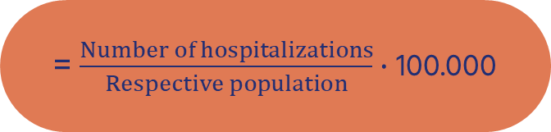
DEFINITIONS
HOSPITALIZATION (RATE)
The number of COVID-19 patients admitted for treatment (per 100,000 population) in a given time period.
= $\frac{Number of hospitalizations}{Respective population}$ · 100.000

Slide 6
DEFINITIONS
NOWCASTING
Problem: Delays in reporting
New hospitalizations being reported daily do not reflect actual numbers
Nowcast: An estimate is provided at the current point in time by using a statistical procedure

Slide 7

DEFINITIONS
DELAYED REPORTS
 | Reported | Updated
01.08.2021 | 407 | 756
02.08.2021 | 416 | 786
407
416
Notes:
6.5

Slide 8
TYPICAL COVID-19 PROGRESSION
Latency period (non-contagious): Ø 2.5 Days
Ø 4 Days
04
Incubation period: Ø 5 – 6 Days
First symptoms
Hospitalization of a severe case
Infected
Contagious
5

Slide 9
BUREAUCRATIC REPORTING PROCESS OF A COVID-19 CASE
Reported at the local health department
First symptoms
Reported at the RKI
Hospitalization of a severe case
Tested positive
Reported date
Hospitalized date
5

Slide 10
WHAT IS ACTUALLY PREDICTED THEN?
The updated hospitalization rate
on the reported date of infection
for the next two weeks
4

Slide 11
02
DATA PROCESSING

Slide 12


DATA COLLECTION
RKI
KITMetricslab
New cases
Hospitalizations
vaccination
Population

Slide 13
FINALIZED DATA SET
Reported date | Year | Calendar week | Index | State | Age group | Population | New cases | Hospitalizations
2020-03-01 | 2020 | 9 | 9 | Bayern | 80+ | 871866 | 0 | 0
2020-03-08 | 2020 | 10 | 10 | Bayern | 80+ | 871866 | 3 | 2
2020-03-15 | 2020 | 11 | 11 | Bayern | 80+ | 871866 | 39 | 25
2020-03-22 | 2020 | 12 | 12 | Bayern | 80+ | 871866 | 214 | 132
2020-03-29 | 2020 | 13 | 13 | Bayern | 80+ | 871866 | 759 | 383
7

Slide 14
03
DATA ANALYSIS

Slide 15


PROBLEMS
Berlin
Brandenburg
4

Slide 16
PROBLEMS
 | New Cases | Hospitalizations
Berlin | 1 | 0
Brandenburg | 0 | 1
4

Slide 17
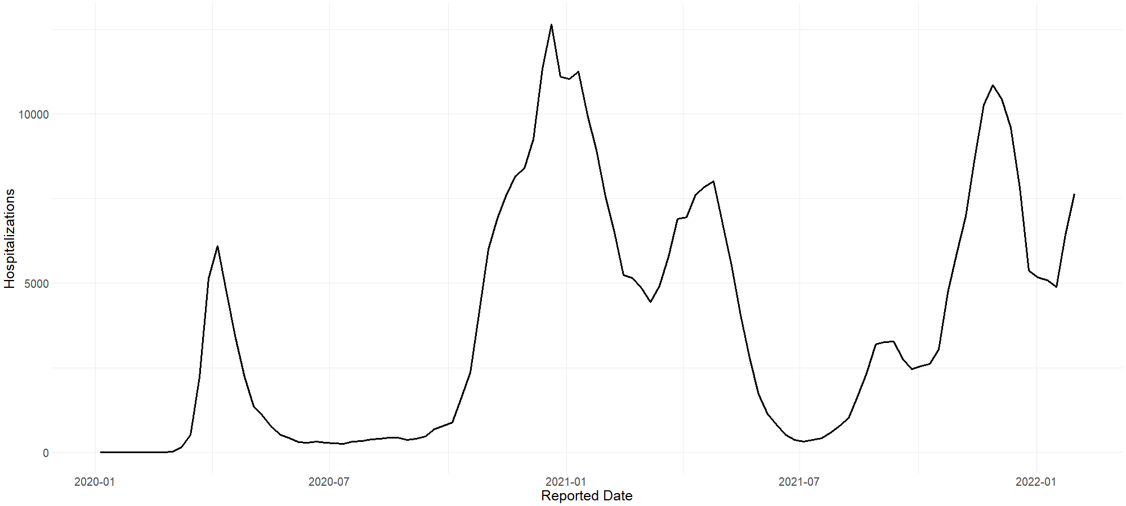
ABSOLUTE NUMBERS OF HOSPITALIZATIONS
13
Notes:
Standard

Slide 18
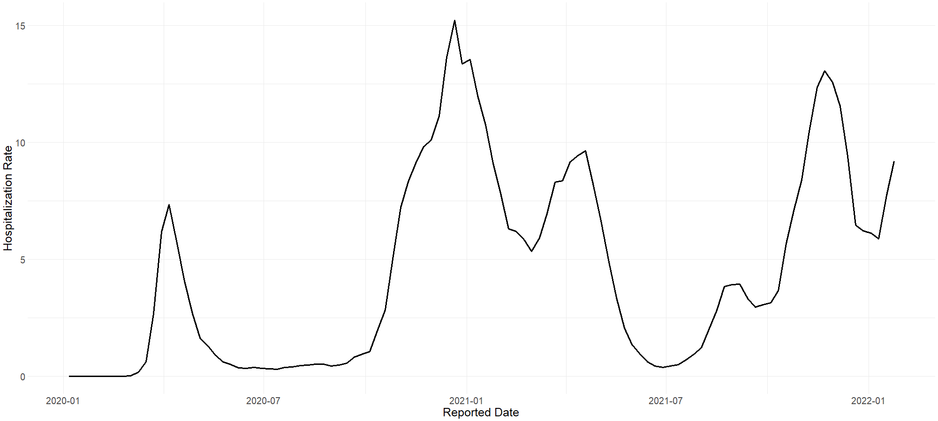
NUMBERS REPORTED BY THE RKI
13
Notes:
Standard

Slide 19
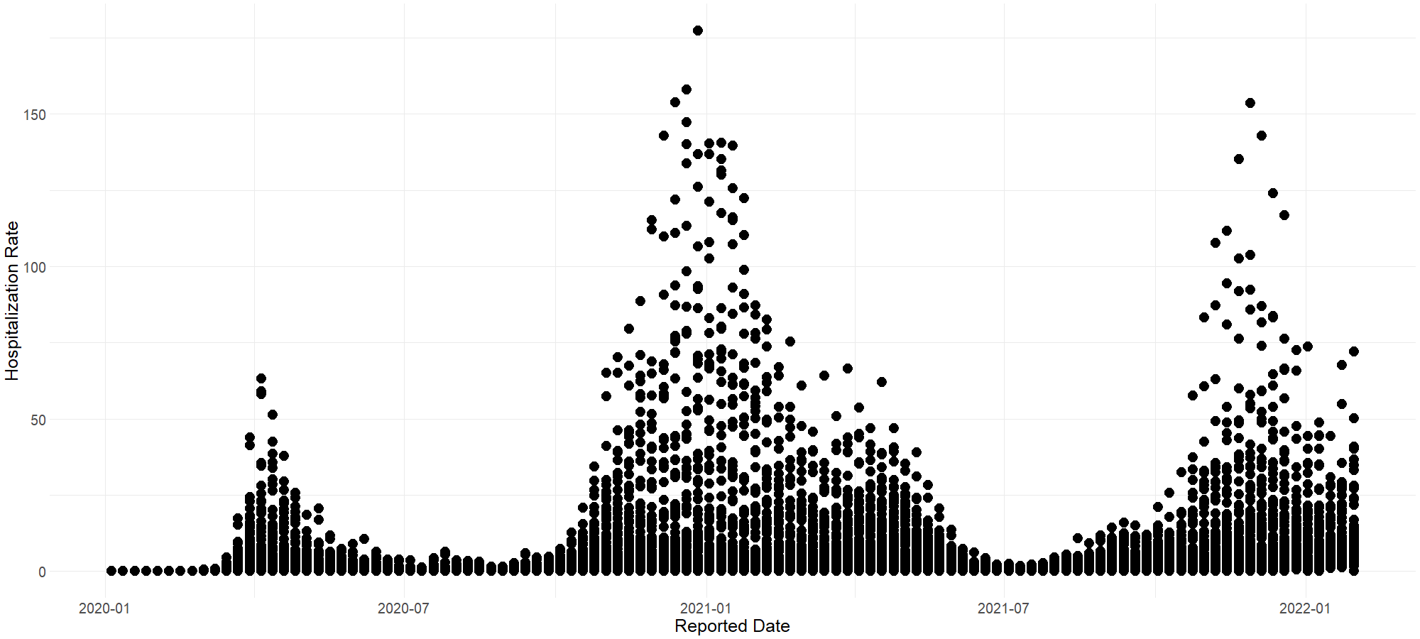
EXPLAINING THE HOSPITALIZATION RATE
13
Notes:
Zerfällt natürlich in einzelne kohorten

Slide 20
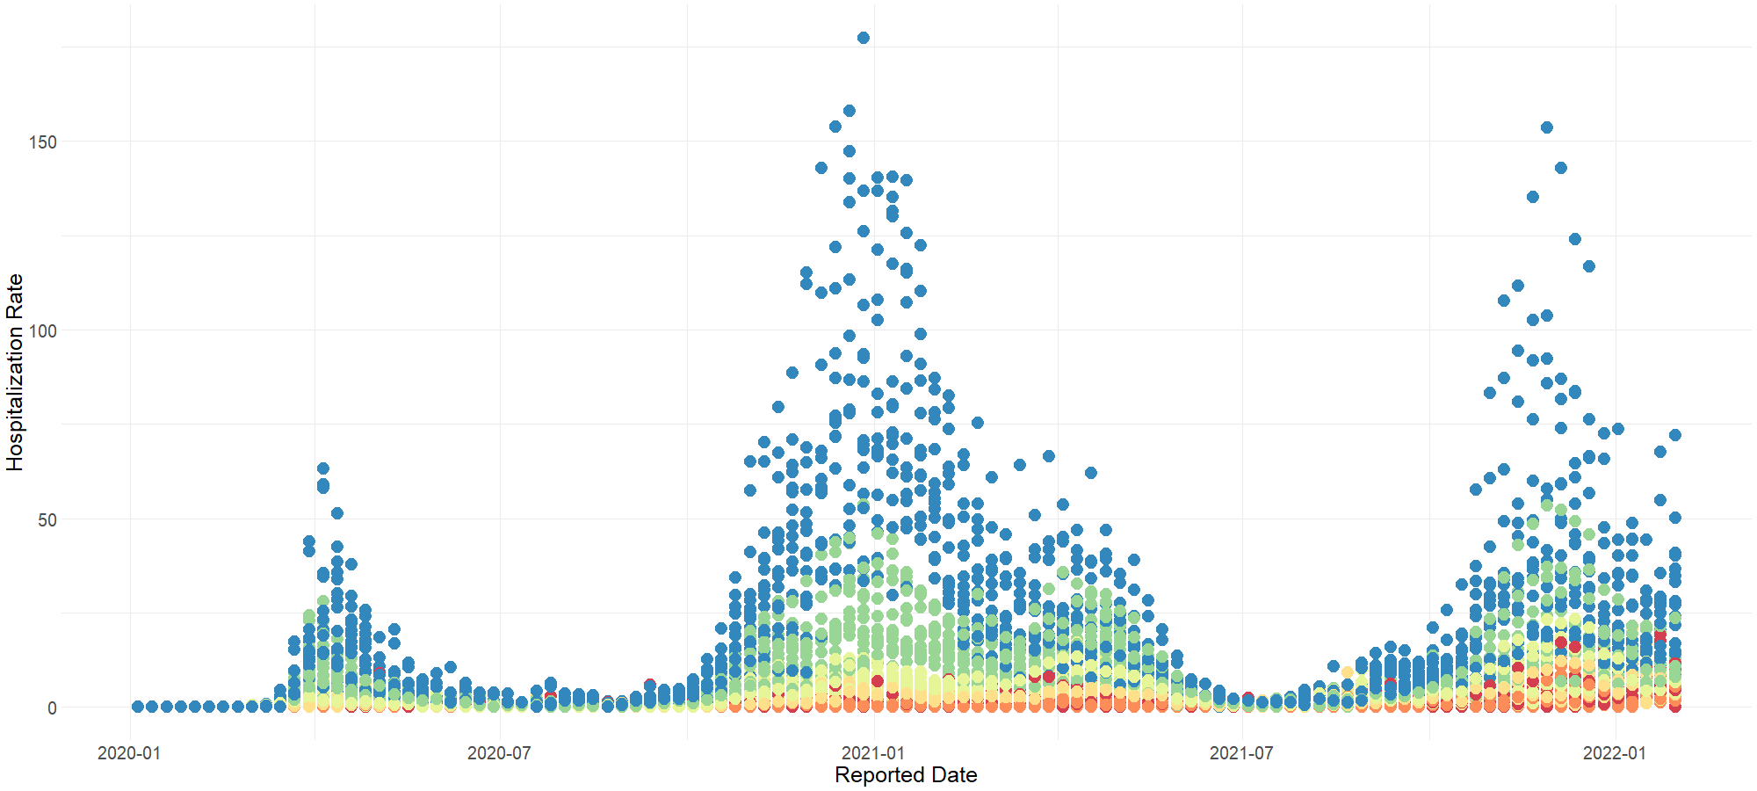

HOSPITALIZATION RATE BROKEN DOWN INTO AGE GROUPS
13
Notes:
Zerfällt natürlich in einzelne kohorten

Slide 21
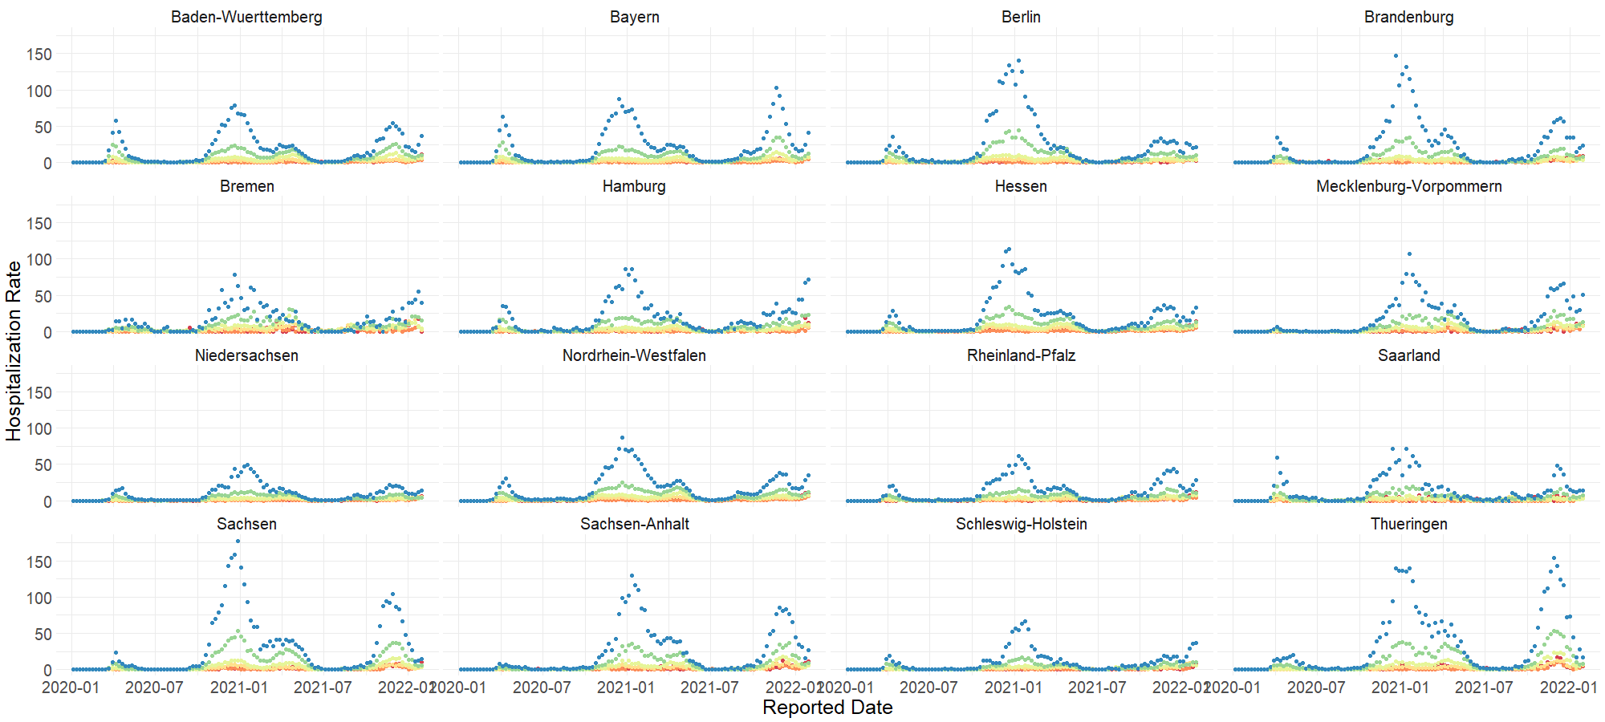
EXPLAINING THE HOSPITALIZATION RATE
13
Notes:
Zerfällt natürlich in einzelne kohorten

Slide 22
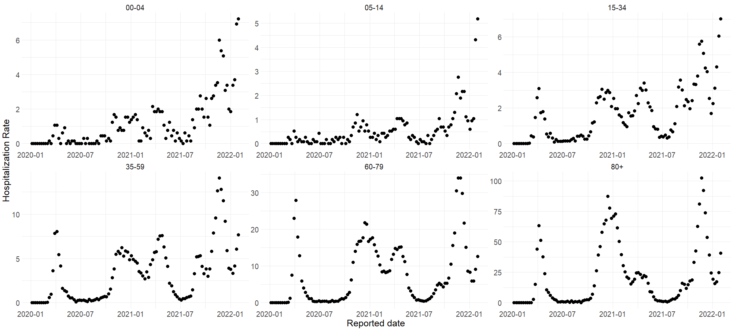
HOSPITALIZATION RATE BY AGE GROUP IN BAYERN
13
Notes:
Zerfällt natürlich in einzelne kohorten

Slide 23
ANALYZING BAYERN BY USING GAM
Distribution assumption: Hospitalization_{i} | x_{i} ~ Poi(λ)
Link: Log
E(Hospitalization_{i}) = exp(β₀ + Agegroup_{i} + f(index_{i},Agegroup_{i}))
Effect of the individual coefficients:
Intercept: exp(1.06) ~ 3
05-14: exp(-0.03) ~ 1
15-34: exp(1.93) ~ 7
35-59: exp(2.77) ~ 16
60-79: exp(2.58) ~ 13
80+: exp(2.3) ~ 10
00-04 and 05-14 are the least impactful age groups.
This holds true for each individual state.
15

Slide 24
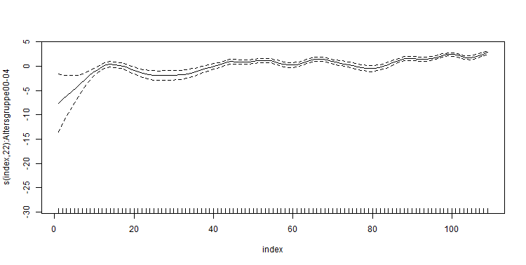
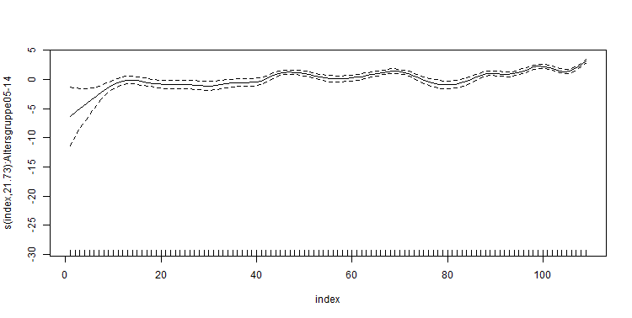
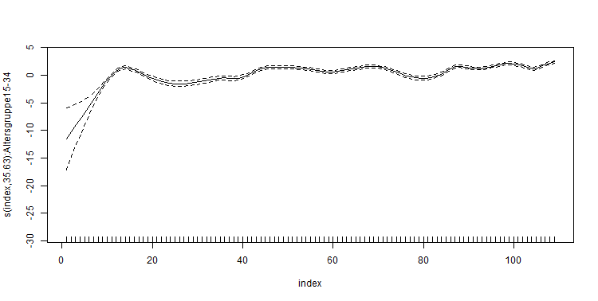
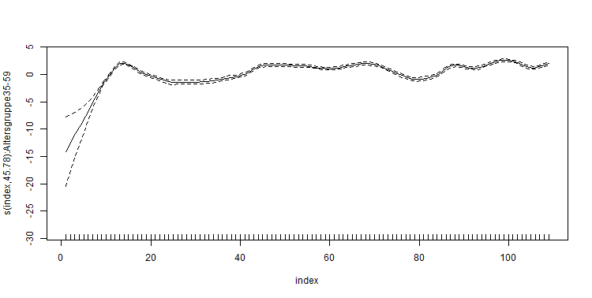
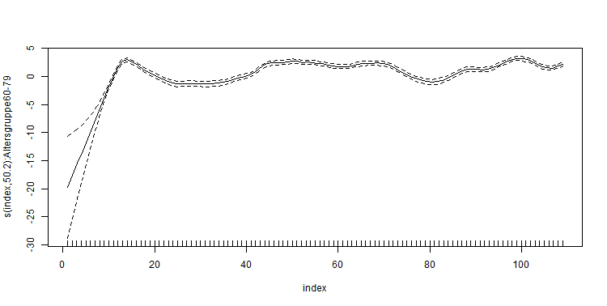

ANALYZING BAYERN BY USING GAM
The effect of the time varying covariable given the age groups stays nearly the same for each age group.
This holds true for each individual state
15
Notes:
Interpretation:
In den ersten kalenderwochen steigt die zahl der hospitalisierungen stark an -> beginn der pandemie (klar).

Slide 25

CONCLUSION
For each age group:
$$E\left({Hospitalization}_{t,j}\right)∝c_{j} ∗θ_{t}$$
$$E\left({Hospitalization}_{t+h,j}\right)∝c_{j} ∗ θ_{t+h}$$
$$⇒E\left({Hospitalization}_{t+h,j}\right)∝ \frac{{E(Hospitalization}_{t,j})}{θ_{t}} ∗θ_{t+h}$$
$$since \frac{θ_{t+h}}{θ_{t}} is independent from j$$
$$⇒X_{t+h,j}∝ θ∗X_{t,j}$$
$$j ∈\{1,…,6\}$$
Or more general:
$$X_{t+h}∝ \sum_{j=1}^{6}{θ ∗ X_{t,j}}$$
$$⇒X_{t+h}∝θ∗X_{t}$$
13
Notes:
As we saw earlier the expected number of hospitalization in each age gorup can be expressed by the effect of the age group c_j and the effect of the timevarying covariable theta_t,j
Since the effect for the timevarying covariable is nearly the same for each individual age group we can then rewrite the equation to E(hosp_t,j) = c_j * theta_t, where theta depends only on the timestamp
By transforming this equation we get that each observation t+h, where t and h are timestamps, can be explained by some factor multiplied by X_t,j
Because theta is constant for each observation and over all agegroups we can now aggregate the agegroups together to receive the more general form
X_t+h = theta * X_t
We are left with a time series formular which we now can try to explain better by using an appropriate model.
Since all until here were theoretical considerations we want to purpose a model which is more accurate for each individual state

Slide 26
04
EXCURSION:
TIME SERIES

Slide 27
TIME SERIES
02
Does the time series show a clear trend or is it stable over the course of time
Stationarity
Is there a seasonal pattern?
Such as the time of the year or the day of the week?
Seasonality

Slide 28
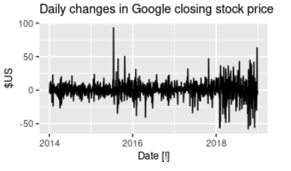
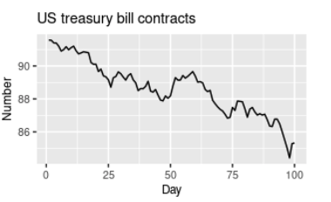
TIME SERIES (EXAMPLES)
A stationary time series
A nonstationary time series
15

Slide 29
TIME SERIES
Every realisation y₁ ,…, y_{n} can be seen as a series of random variables Y₁ ,...,Y_{n}.
If the (joint) distribution of Y₁ ,…, Y_{n} is known, one can predict every realisation of these random variables
15

Slide 30


3 IMPORTANT ASPECTS OF THE TIME SERIES
Mean
μ_{t} = E(Y_{t}) = $\int_{−∞}^{∞}{y ·\text{f}\text{t}\text{(}\text{y}\text{)} dy}$
With t time and μ_{t} mean of each random variable Y₁ ,...,Y_{n}
γ(s,t) = Cov(Y_{s},Y_{t}) = E(Y_{s} - μ_{s})(Y_{t} - μ_{t})
Is the covariance function.
It depends on the two timestamps s and t
Covariance
ρ(s,t) = $\frac{\text{γ}\text{(}\text{s}\text{,}\text{t}\text{)}}{\sqrt{γ(s,s)·γ(t,t)}}$
Is the correlation function
Correlation
15

Slide 31
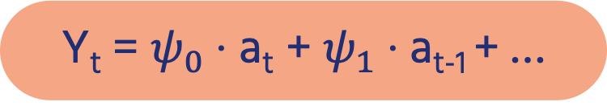
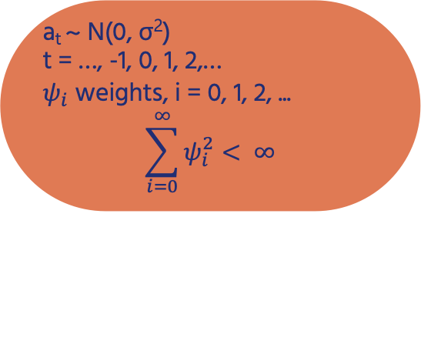
LINEAR TIME SERIES
Y_{t} = $ψ_{0}$· a_{t} + $ψ_{1}$· a_{t-1} + …
a_{t} ~ N(0, σ²)
t = …, -1, 0, 1, 2,…
$ψ_{i}$ weights, i = 0, 1, 2, ...
$$\sum_{i=0}^{∞}{ψ_{i}^{2}}< ∞$$
Backshift-Operator
Bx_{t} = x_{t-1}; Bx_{t-3} = x_{t-4}
B²x_{t} =x_{t-2} ; (1 - B)x_{t} = x_{t} – x_{t-1}
(1 - B)²x_{t} = (1 – 2B + B²)x_{t} = x_{t} – 2x_{t-1} + x_{t-2}
15
Notes:
Sum of weights squared must be smaller than Inf, to keep the variance of X_t finit

Slide 32
IMPORTANT ASPECTS OF THE LINEAR TIME SERIES
ACF/Autocorrelation - ρ(h)
Measurement of information that Y_{t} provides to estimate Y_{t+h}
PACF/Partial autocorrelation - τ(h)
Measurement of information that Y_{t} provides to estimate Y_{t+h} given Y_{t+1} ,..,Y_{t+h-1}
15

Slide 33
DIFFERENT TYPES OF TIME SERIES
Suitable for stationary time series
Moving average models - MA(q)
Autoregressive models - AR(p)
Autoregressive moving average models - ARMA(p,q)
Autoregressive integrated moving average models - ARIMA(p,d,q)
Autoregressive integrated moving average models with seasonal component - ARIMA(P,D,Q)_{s}
Suitable for non-stationary time series
15

Slide 34
EXAMPLE: AUTOREGRESSIVE MODEL - AR(p)
AR(p) model is defined by:
Y_{t} = φ₁·Y_{t-1} + φ₂·Y_{t-2} + … + a_{t} (with t = 1, 2, …)
⬄ (1 – φ₁·B – φ₂·B² … ) + Y_{t} = a_{t}
AR(1):
Y_{t} = φ·Y_{t-1} + a_{t} (with t = 1, 2, …)
⬄ y_{t} = b₀ + b₁·x_{t} + ε_{t}
Where b₀ = 0 and x_{t} = y_{t-1}
15

Slide 35
05
MODEL INTRODUCTION

Slide 36
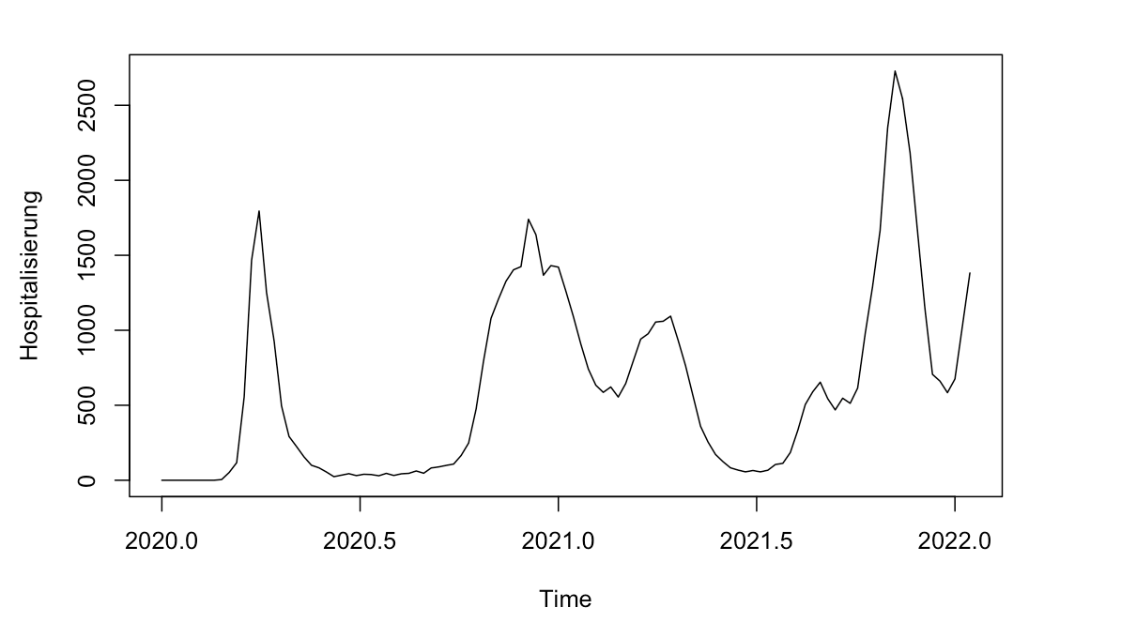
ANALYZING THE TIME SERIES (BAYERN)
W_{t} = Y_{t} – Y_{t-1}
Stationary time series
(no clear trend visible)
15

Slide 37
UTILIZING AUTO.ARIMA
Hyndman-Khandakar algorithm for automatic ARIMA modelling
auto.arima first checks for stationarity using unit root test
p and q are chosen by minimising the AIC after differencing the data d times
Four initial models are fitted:
ARIMA(0,d,0)
ARIMA(2,d,2)
ARIMA(1,d,0)
ARIMA(0,d,1)
Best model with smallest AIC is then tested on different values for p and q
Steps are repeated until lowest AIC is reached
15

Slide 38
UTILIZING AUTO.ARIMA (BAYERN)
Suggested Model: ARIMA(1,0,2)(0,1,0)[53]
ARIMA(1, 0, 2) for trend
ARIMA(0, 1, 0)[53] for season
X
Differences of 1. Order: W_{t} = Y_{t} – Y_{t-1}
(The differences are the I in ARIMA)
15

Slide 39
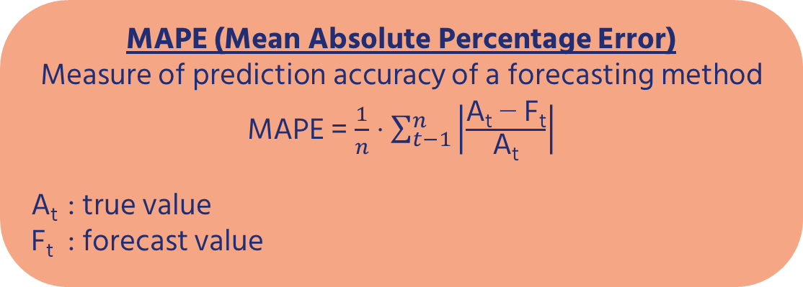
MODEL EVALUATION (BAYERN)
MAPE (Mean Absolute Percentage Error)
Measure of prediction accuracy of a forecasting method
MAPE = $\frac{1}{n}$ · $\sum_{t−1}^{n}{\left|\frac{\text{A}\text{t}\text{ −} \text{F}\text{t}}{\text{A}\text{t}}\right|}$
A_{t} : true value
F_{t} : forecast value
MAPE at one week:
13%
MAPE at two weeks:
25.7%
15

Slide 40
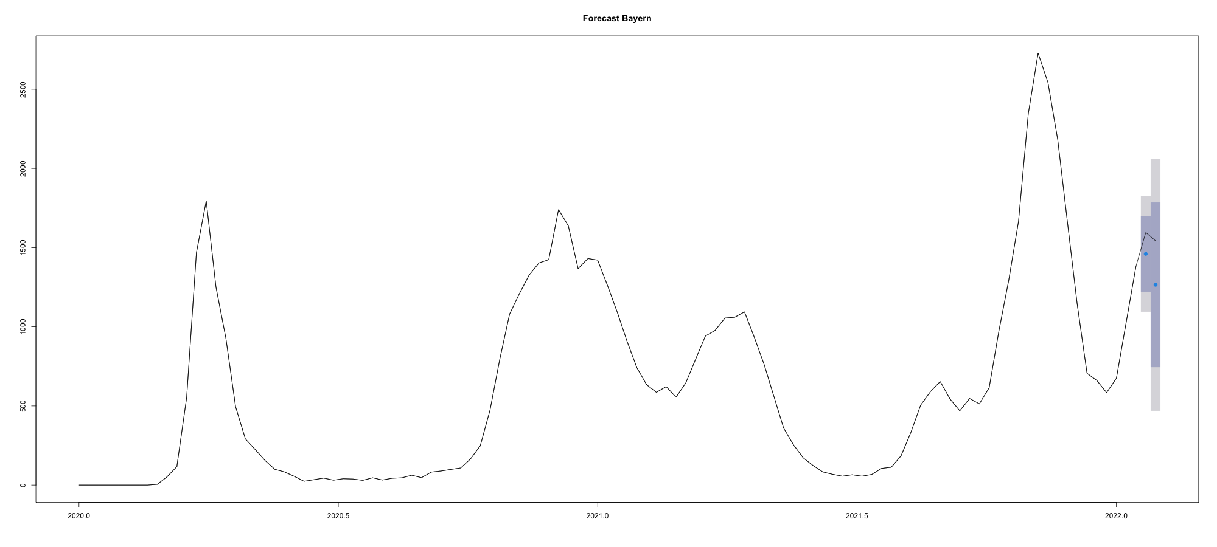
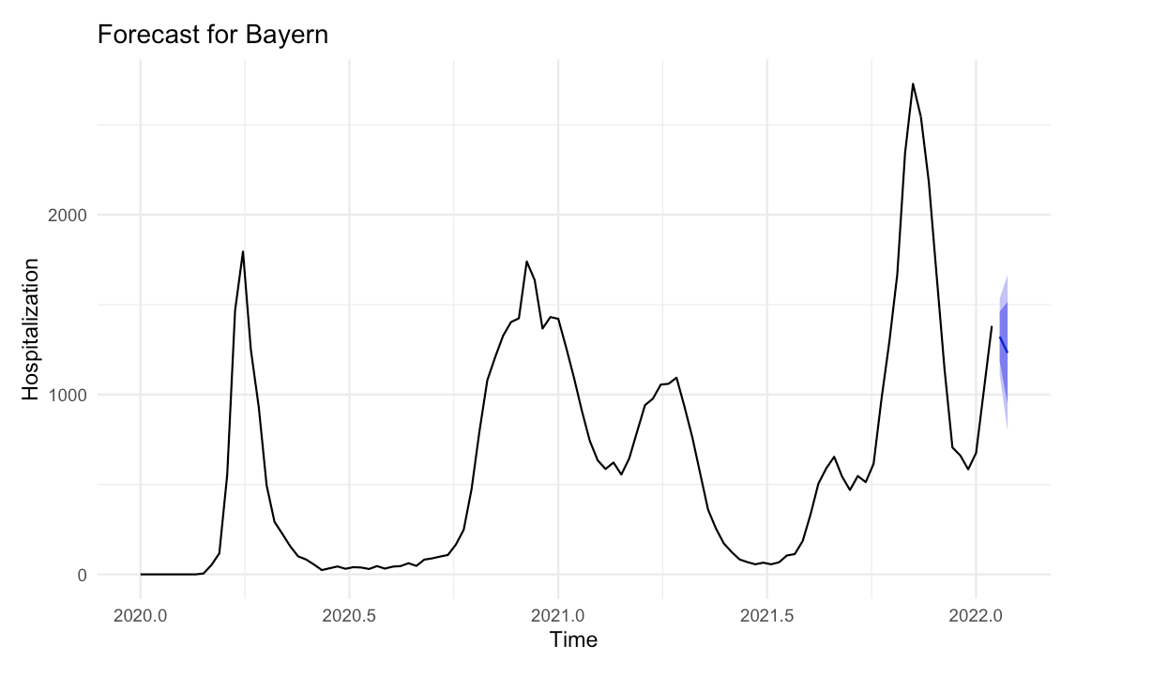
FORECAST FOR BAYERN
15

Slide 41
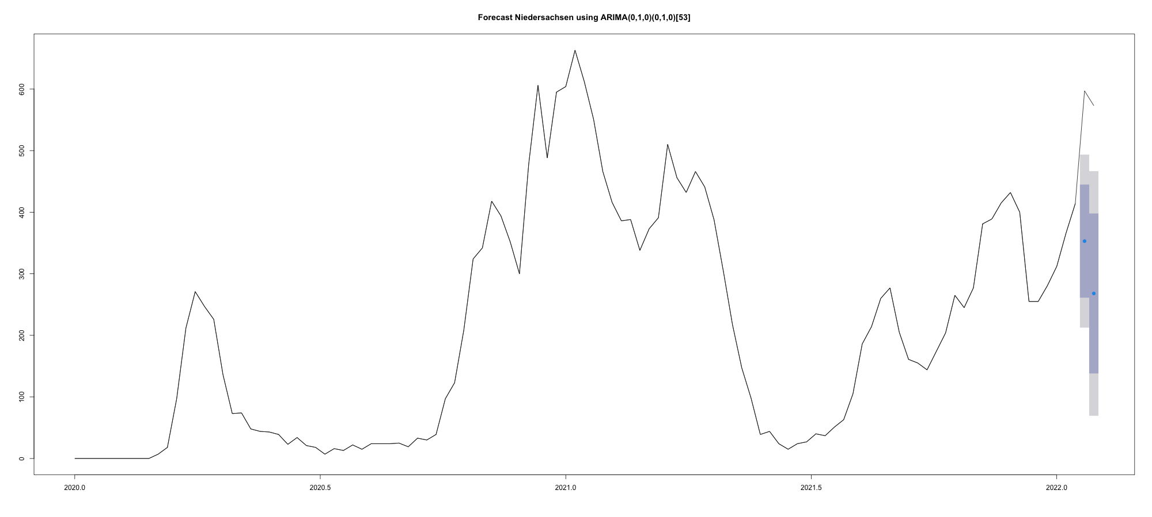
FORECAST FOR NIEDERSACHSEN
15
Notes:
MAPE for one week on testdata: 1.3%, for two weeks 12% but: forecast way worse

Slide 42
SUMMARY
The predictions should be used with care
No information regarding second infections or hospitalizations due to anonymity
Only two years of data
A lot of potential information that could be missing in the univariate time series
17

Slide 43
SUMMARY
Kinds of data we were unable to obtain:
The exact number of infections
Can people be hospitalized multiple times
The exact date of hospitalization
Possible indicators (previous illness, smoking etc.)
17

Slide 44
Diskussionsrunde
05

Slide 45
ANHANG
19

Slide 46
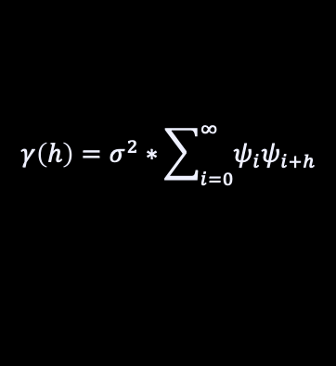

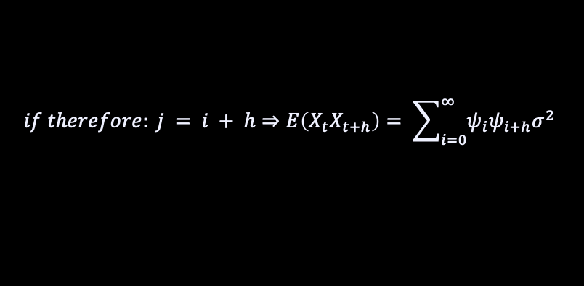

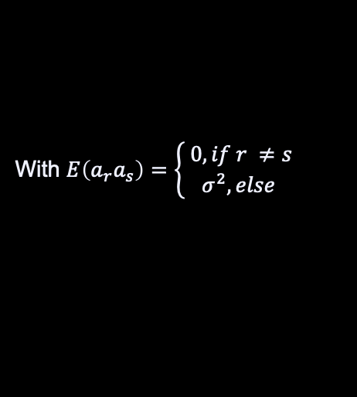


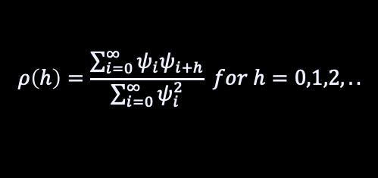
Definition ACF
Def. Linear Time Series:
$X_{t}= ψ_{0}∗a_{t}+ …= \sum_{i=0}^{∞}{ψ_{t}∗a_{t−i}}$
With $\sum_{i=0}^{∞}{ψ_{i}^{2}}< ∞$
$$E\left(X_{t}\right)=E\left(\sum_{i=0}^{∞}{ψ_{i}∗a_{t−i}}\right)=\sum_{i=0}^{∞}{ψ_{i}∗E\left(a_{t−i}\right)=0}$$
$$Cov\left(X_{t}, X_{t+h}\right)=E\left(X_{t}−E\left(X_{t}\right)\right)\left(X_{t+h}−E\left(X_{t+h}\right)\right)=E\left(X_{t}X_{t+h}\right)=$$
$$E\left((\sum_{i=0}^{∞}{ψ_{i}∗a_{t−i}})(\sum_{i=0}^{∞}{ψ_{i}∗a_{t+h−i}})\right)=…= \sum_{i=0}^{∞}{ψ_{i}}(\sum_{j=0}^{∞}{ψ_{j}∗E\left(a_{t−i}a_{t+h−j}\right)}$$
With $E\left(a_{r}a_{s}\right)=\left\{\begin{aligned} 0,if r ≠s \\ σ^{2}, else\end{aligned}\right.$
$$if therefore: j = i + h⇒E\left(X_{t}X_{t+h}\right)= \sum_{i=0}^{∞}{ψ_{i}ψ_{i+h}σ^{2}}$$
$$γ\left(h\right)=σ^{2}∗\sum_{i=0}^{∞}{ψ_{i}ψ_{i+h}}$$
$$ρ\left(h\right)=\frac{\sum_{i=0}^{∞}{ψ_{i}ψ_{i+h}}}{\sum_{i=0}^{∞}{ψ_{i}^{2}}} for h=0,1,2,..$$
and
13

Slide 47

Definition MA(q)
$X_{t}=a_{t}−θ_{1}a_{t−1}−θ_{2}a_{t−2}−…−θ_{q}$ $a_{t−q} with θ_{q} ≠0$
Therefore it is a linear time series with:
$$ψ_{0}=1, ψ_{1}=−θ_{1},…,ψ_{q}=−θ_{q} and ψ_{k}=0 for k>q$$
13

Slide 48
Definition ARMA
Combination of AR(p) and MA(q) models
$$φ\left(B\right)X_{t}=θ\left(B\right)a_{t} ↔$$
$$\left(1−φ_{1}B−φ_{2}B^{2}−…−φ_{p}B^{p}\right)X_{t}=\left(1−θ_{1}B−θ_{2}B^{2}−…−θ_{q}B^{q}\right)a_{t}$$
13

Slide 49
Definition ARIMA(p,d,q)
Differences of 1. Order: $W_{t}=X_{t}−X_{t−1}=(1−B)X_{t}$
Differences of d-th Order: $W_{t}={(1−B)}^{d}X_{t};t=d+1,…,n$
$$If W_{t} is stationary one can try to fit an ARMA\left(p,q\right)−model$$
$Therefore the new model for X_{t} is: φ\left(B\right){\left(1−B\right)}^{d}X_{t}=θ(B)a_{t}$
13

Slide 50
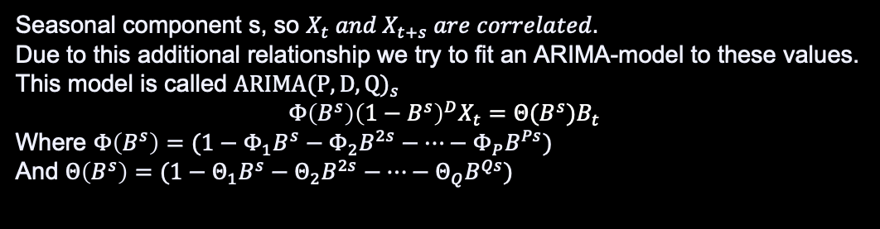

Definition ARIMA(P,D,Q)_s
Seasonal component s, so $X_{t} and X_{t+s} are correlated.$
Due to this additional relationship we try to fit an ARIMA-model to these values.
This model is called
Where $Φ\left(B^{s}\right)=(1−Φ_{1}B^{s}−Φ_{2}B^{2s}−…−Φ_{P}B^{Ps})$
And $Θ\left(B^{s}\right)=(1−Θ_{1}B^{s}−Θ_{2}B^{2s}−…−Θ_{Q}B^{Qs})$
The $B_{t}$ can be described by an ordinary ARIMA(p,d,q)-model
By combining those two models we receive the socalled
$multiplicative ARIMA\left(p,d,q\right)x{(P,D,Q)}_{s}$ model
$$φ\left(B\right)Φ\left(B^{s}\right){\left(1−B\right)}^{d}{\left(1−B^{s}\right)}^{D}X_{t}=θ(B)Θ(B^{s})a_{t}$$
13

Slide 51
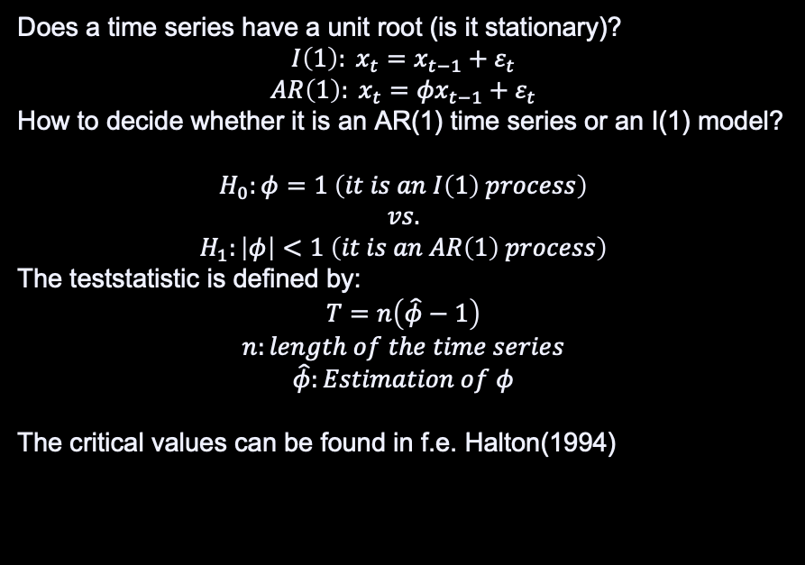
Definition Unit root Test
Does a time series have a unit root (is it stationary)?
$$I\left(1\right): x_{t}=x_{t−1}+ε_{t}$$
$$AR\left(1\right): x_{t}={φx}_{t−1}+ε_{t}$$
How to decide whether it is an AR(1) time series or an I(1) model?
$$H_{0}:φ=1 \left(it is an I\left(1\right) process\right)$$
$$vs.$$
$$H_{1}:\left|φ\right|<1 \left(it is an AR\left(1\right) process\right)$$
The teststatistic is defined by:
$$T=n\left(\hat{φ}−1\right)$$
$$n:length of the time series$$
$$\hat{φ}:Estimation of φ$$
The critical values can be found in f.e. Halton(1994)
13

Slide 52
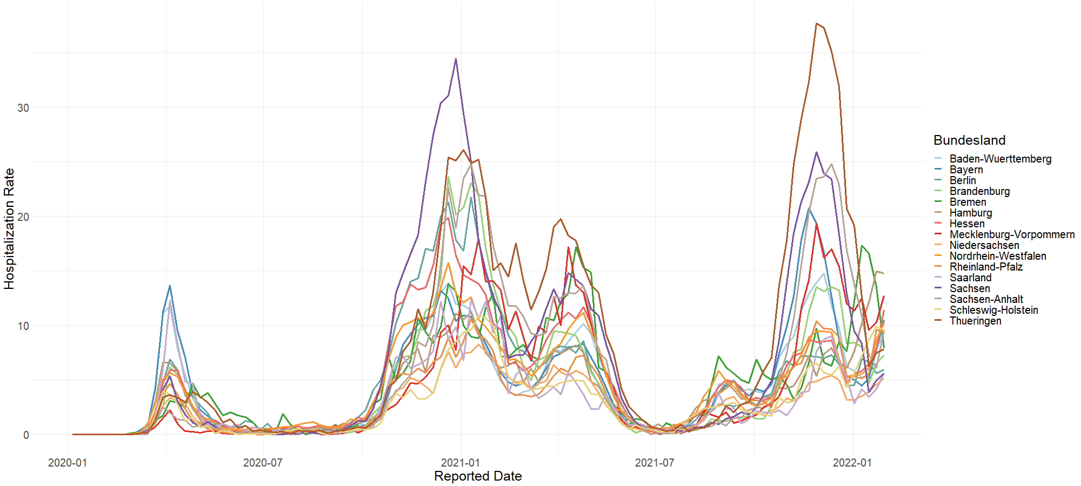
HOSPITALIZATION RATE BY STATE
13
Notes:
Hier normierung auf die population um effekte des trends zu beobachten
Der trend für jedes Bundesland ist unterschiedlich stark
Insgesamt ein steigender trend zu beobachten

Slide 53
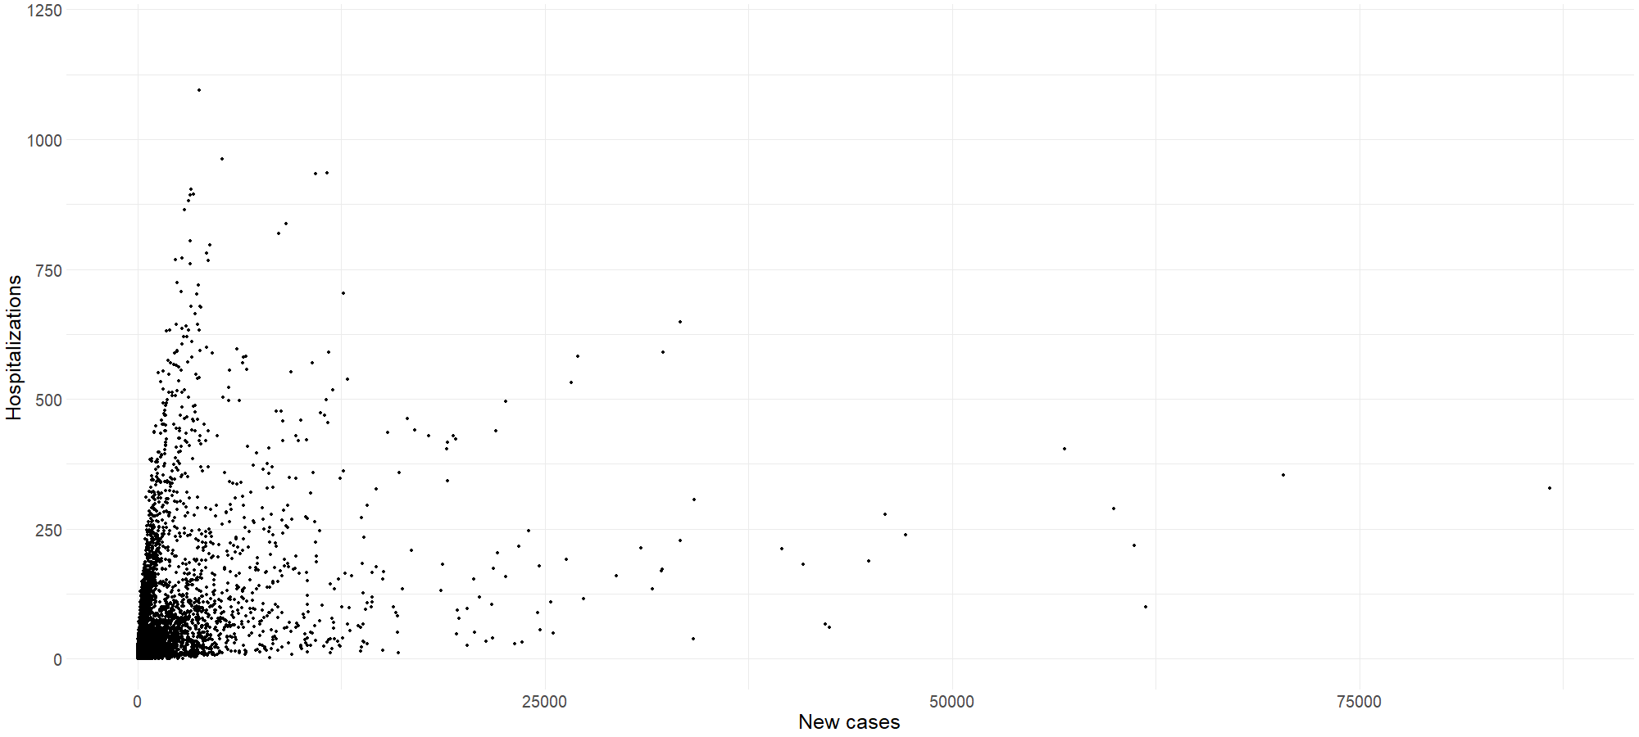
HOSPITALIZATIONS VS. NEW CASES
13

Slide 54
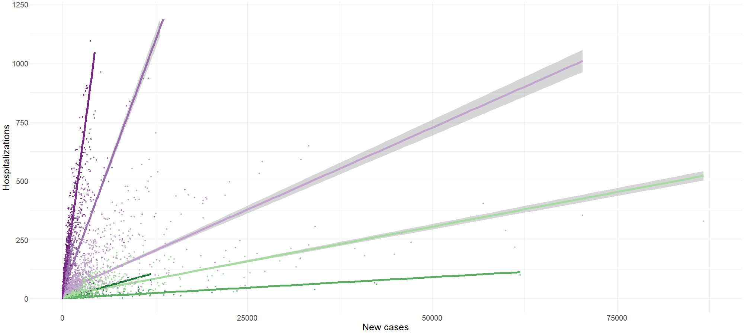

HOSPITALIZATIONS VS. NEW CASES
13

Slide 55
TIME SERIES
Mercury
02
Saturn
01
Jupiter
03
Mercury is the closest planet to the Sun
Saturn is composed of hydrogen and helium
It’s the biggest planet in the Solar System

